Slide 1




Week-2 (Discussion)
5th August, 2024
Introduction to Machine Learning
Prof. Balaraman Ravindran
Professor and Head of the Department
Department of Data Science and Artificial Intelligence
IIT Madras
Ayan Paul
PMRF Research Scholar
IIT Kharagpur

Slide 2
All models are wrong,
But some are useful.
-G. Box

Slide 3



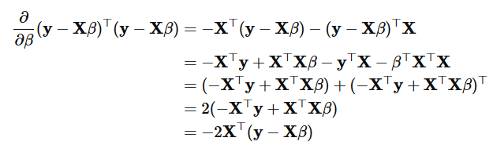
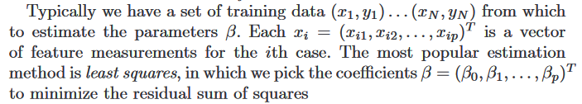

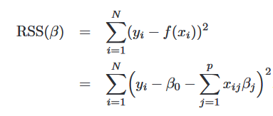



Linear Regression Models and Least Squares
X the N × (p + 1) matrix with each row an input vector, and similarly let y be the N -vector of outputs in the training set
Minimising the RSS

Slide 4
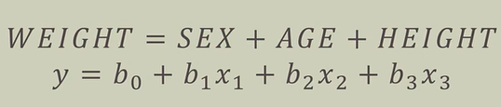
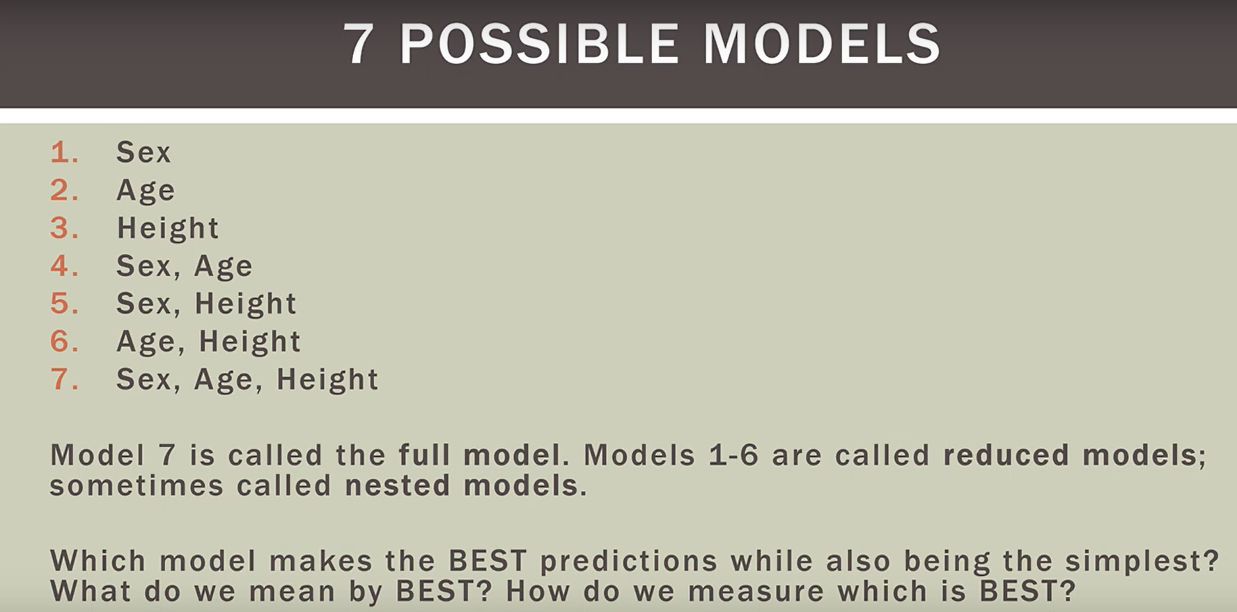
A Linear Regression Model Example with inputs

Slide 5
Dimensionality of inputs
Number of Inputs (e.g. age and income)
If number of inputs is increased
More time to compute
More memory to store inputs and intermediate results
More complicated explanations (knowledge from learning)
Regression from 100 vs. 2 parameters
No simple visualization
2D vs. 10D graph
Need much more data (curse of dimensionality)
1M of 1-d inputs is not equal to 1 input of dimension 1M

Slide 6
Feature Selection vs Extraction
Some features (dimensions) bear little or nor useful information (e.g. color of hair for a car selection)
Can drop some features
Have to estimate which features can be dropped from data
Several features can be combined together without loss or even with gain of information (e.g. income of all family members for loan application)
Some features can be combined together
Have to estimate which features to combine from data
Feature selection: Choosing k<p important features, ignoring the remaining p – k
Subset selection algorithms
Feature extraction: Project the original x_{i} , i =1,...,p dimensions to new k<d dimensions, z_{j} , j =1,...,p
Principal Components Analysis (PCA)

Slide 7
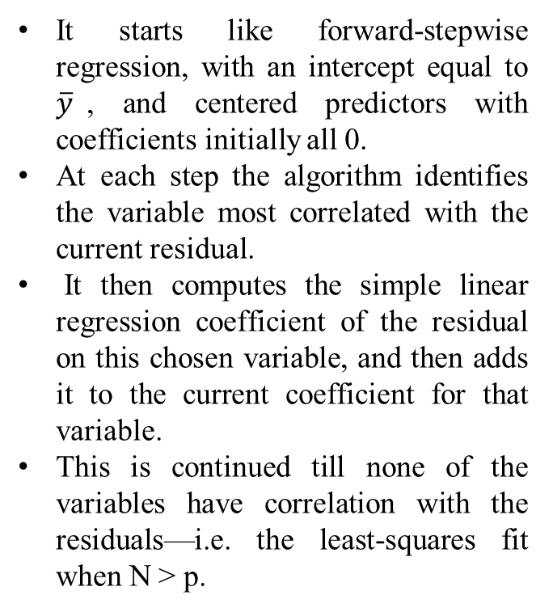
Subset Selection
Two reasons why we are often not satisfied with the least squares estimates
Prediction accuracy
Interpretation
Forward-Stagewise Regression
Forward-Stepwise Selection
Backward-Stepwise Selection
Stepwise selection starts with the intercept, and then sequentially adds into the model the predictor that most improves the fit.
Backward-stepwise selection starts with the full model, and sequentially deletes the predictor that has the least impact on the fit.
Backward selection can only be used when N > p, while forward stepwise can always be used.

Slide 8
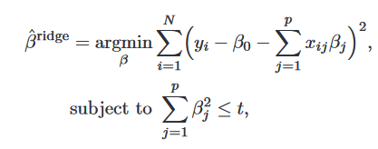
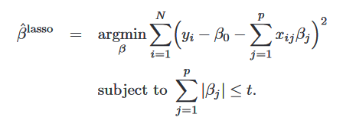




Shrinkage Methods
By retaining a subset of the predictors and discarding the rest, subset selection produces a model that is interpretable and has possibly lower prediction error than the full model.
However, because it is a discrete process variables are either retained or discarded—it often exhibits high variance, and so doesn’t reduce the prediction error of the full model.
Shrinkage methods are more continuous, and don’t suffer as much from high variability.
Here λ ≥ 0 is a complexity parameter that controls the amount of shrinkage: the larger the value of λ, the greater the amount of shrinkage. The coefficients are shrunk toward zero (and each other).
Lasso Regression
Ridge Regression

Slide 9
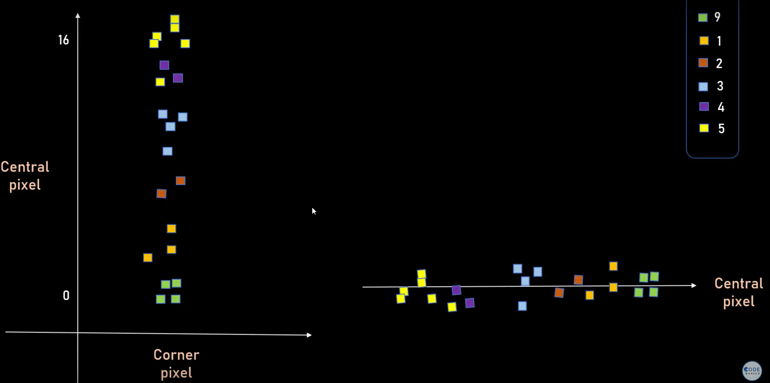
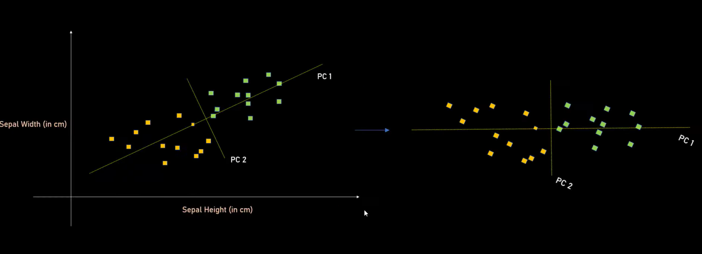
Principal Component Analysis (PCA)
Principal Component Analysis(PCA) technique was introduced by the mathematician Karl Pearson in 1901.
It works on the condition that while the data in a higher dimensional space is mapped to data in a lower dimension space, the variance of the data in the lower dimensional space should be maximum.

Slide 10
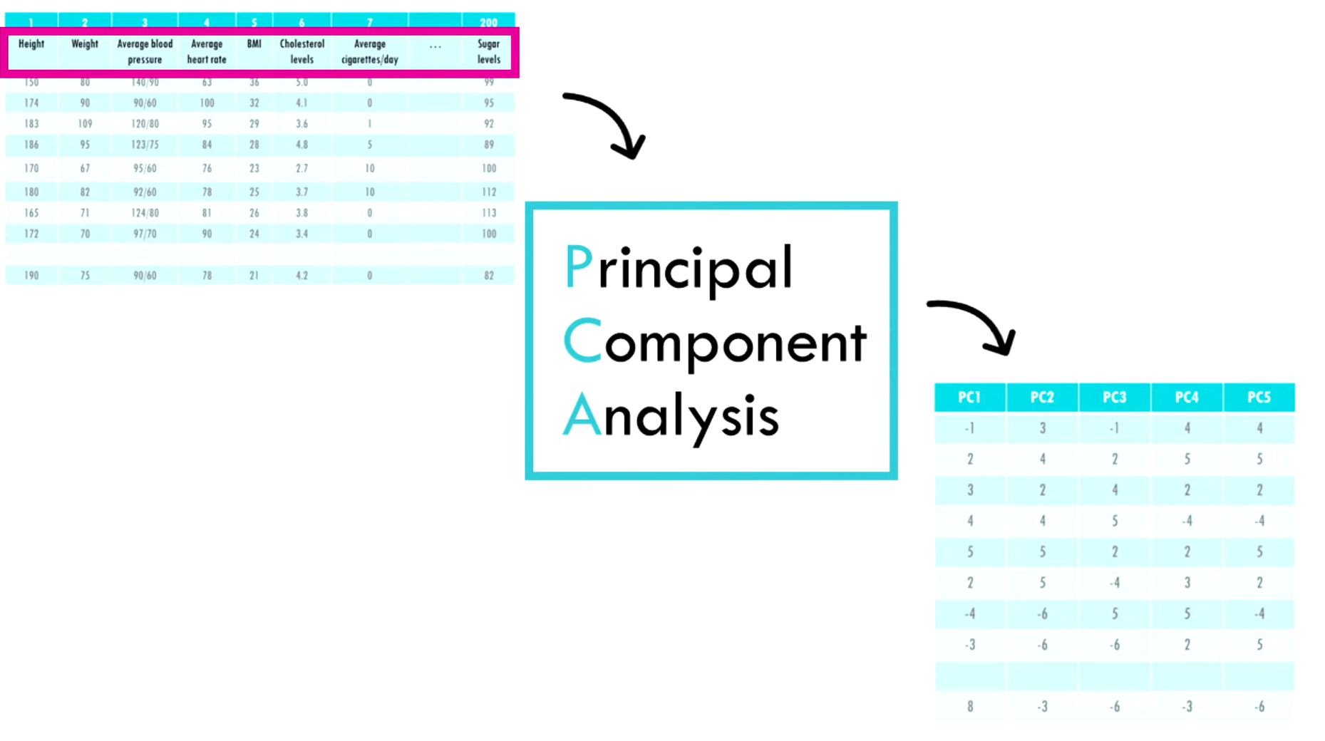
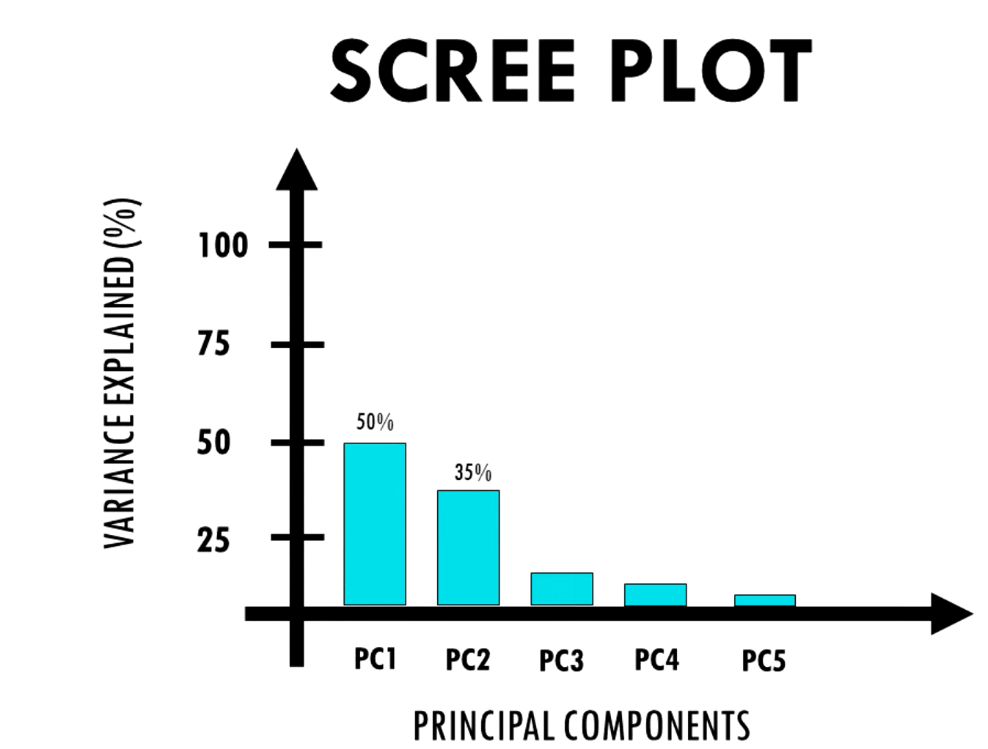
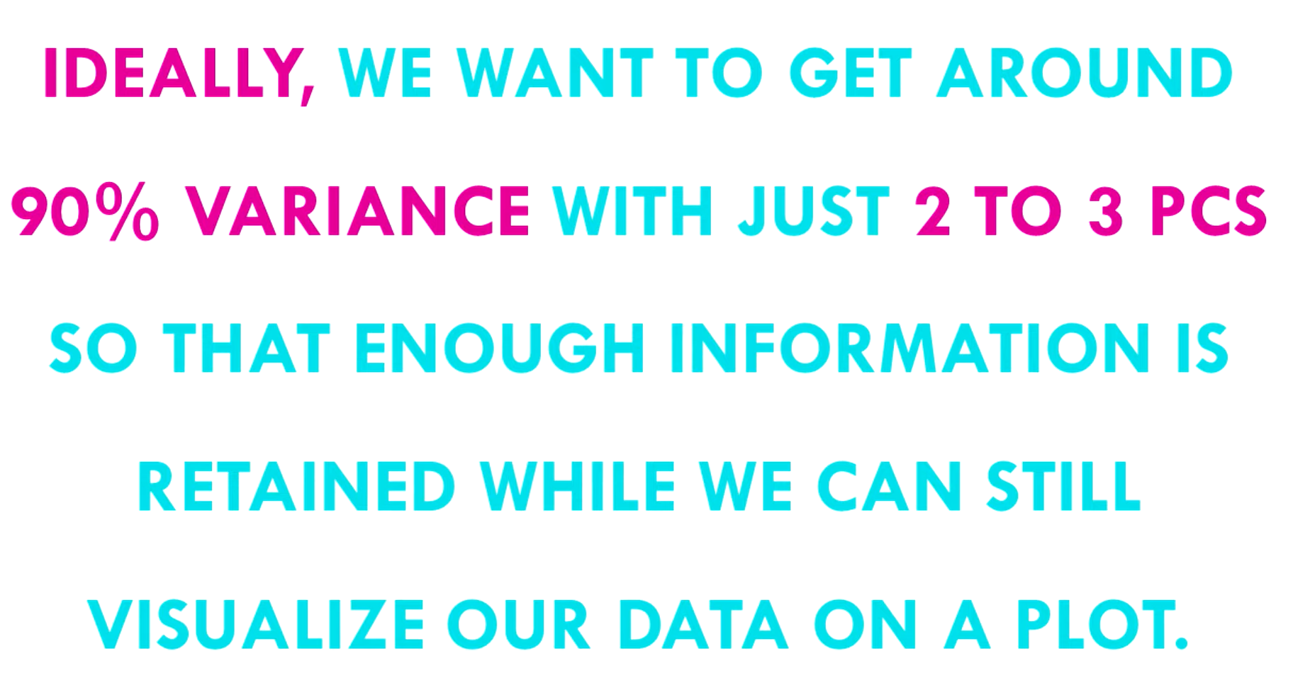


Slide 11
Topics on which Week 2 Assignment Questions are based
Linear Regression
Multivariate Regression
Subset Selection
Shrinkage Methods
Principal Component Regression
Partial Least Squares

Slide 12
QUESTION 1
The parameters obtained in linear regression
a) can take any value in the real space
b) are strictly integers
c) always lie in the range [0,1]
d) can take only non-zero values
SOLUTION 1
The parameters obtained in linear regression can take any value in the real space
CORRECT ANSWER 1
a)

Slide 13
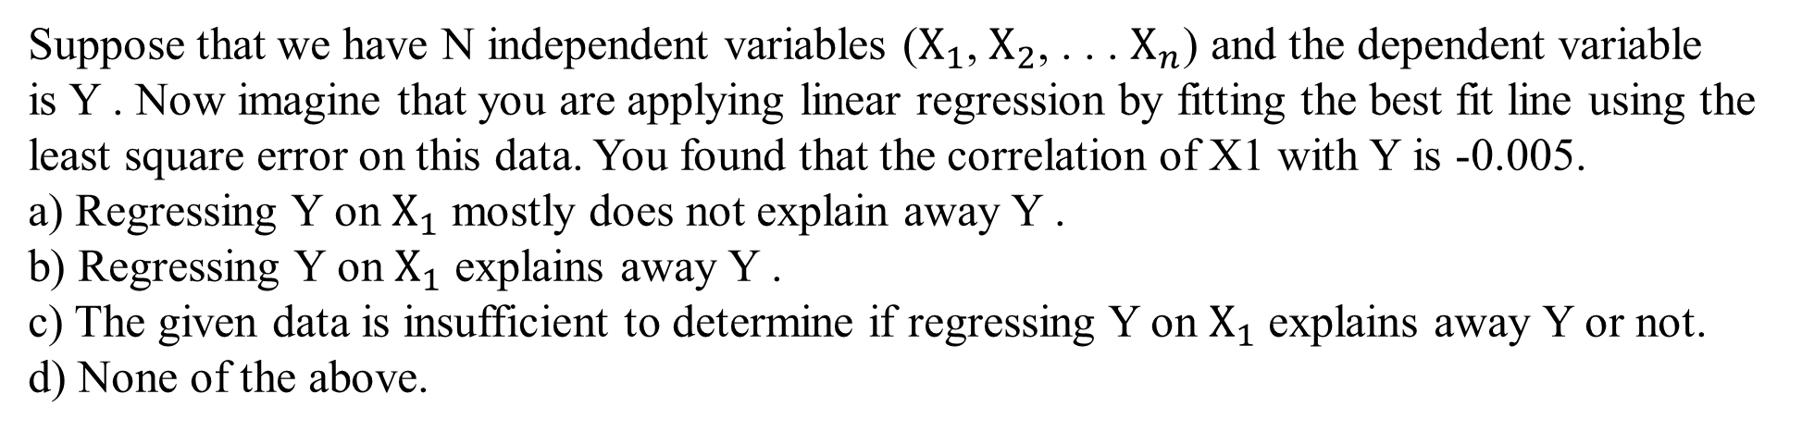
QUESTION 2
SOLUTION 2
CORRECT ANSWER 2
a)

Slide 14
QUESTION 3
The relation between studying time (in hours) and grade on the final examination (0-100) in
a random sample of students in the Introduction to Machine Learning Class was found to be:
Grade = 30.5 + 15.2(h)
How will a student’s grade be affected if she studies for four hours, compared to not studying?
(a) It will go down by 30.4 points.
(b) It will go up by 60.8 points.
(c) The grade will remain unchanged.
(d) It cannot be determined from the information given
SOLUTION 3
The slope of the regression line gives the average increase in grade for every hour increase in
studying. So, if studying is increased by four hours, the grade will increase by 4×(15.2) = 60.8.
CORRECT ANSWER 3
b)

Slide 15
QUESTION 4
Consider the following 4 training examples:
We want to learn a function f(x) = ax+b which is parametrized by (a, b). Using squared error
as the loss function, which of the following parameters would you use to model this function.
a) (1,1)
b) (1,2)
c) (2,1)
d) (2,2)
x | y
-1 | 0.0319
0 | 0.8692
1 | 1.9566
2 | 3.0343
SOLUTION 4
The line y = x + 1 is the one with minimum squared error out of all the four proposed.
CORRECT ANSWER 4
a)

Slide 16
QUESTION 5
Consider a modified k-NN method in which once the k nearest neighbours to the query point
are identified, you do a linear regression fit on them and output the fitted value for the query
point. Which of the following is/are true regarding this method.
a) This method makes an assumption that the data is locally linear.
b) In order to perform well, this method would need dense distributed training data.
c) This method has higher bias compared to k-NN
d) This method has higher variance compared to k-NN
SOLUTION 5
Since we are doing a linear fit in the k-neighborhood, we are making an assumption of local linearity. Hence, (a) holds. The method would need dense distributed training data to perform well, since in the case of the training data being sparse, the k-neighborhood would end up being quite spread out (not really local anymore). Hence, the assumption of local linearity would not give good results. Hence, (b) holds. The method has higher variance, since we now have two parameters (slope and intercept) instead of one in the case of conventional k-NN. (In the conventional case, we just try to fit a constant, and the average happens to be the constant which minimizes the squared error).
CORRECT ANSWER 5
a), b), d)

Slide 17
QUESTION 6
Which of the following is a L2 regularization?
a) Ridge regression.
b) Lasso regression.
c) Both (a) and (b).
d) None of the (a) and (b).
SOLUTION 6
Ridge regression is a L2 regularization while Lasso is L1.
CORRECT ANSWER 6
a)

Slide 18
QUESTION 7
Choose the correct option(s) from the following:
a) When working with a small dataset, one should prefer low bias/high variance classifiers
over high bias/low variance classifiers.
b) When working with a small dataset, one should prefer high bias/low variance classifiers
over low bias/high variance classifiers.
c) When working with a large dataset, one should prefer high bias/low variance classifiers
over low bias/high variance classifiers.
d) When working with a large dataset, one should prefer low bias/high variance classifiers
over high bias/low variance classifiers.
SOLUTION 7
On smaller datasets, variance is a concern since even small changes in the training set may
change the optimal parameters significantly. Hence, a high bias/low variance classifier would be preferred. On the other hand, with a large dataset, since we have sufficient points to represent the data distribution accurately, variance is not of much concern. Hence, one would go for the classifier with low bias even though it has higher variance.
CORRECT ANSWER 7
b), d)

Slide 19
QUESTION 8
Consider the following statements:
Statement A: In Forward stepwise selection, in each step, that variable is chosen which has the
maximum correlation with the residual, then the residual is regressed on that variable, and it
is added to the predictor.
Statement B: In Forward stagewise selection, the variables are added one by one to the previously selected variables to produce the best fit till then
a) Both the statements are True.
b) Statement A is True, and Statement B is False
c) Statement A if False and Statement B is True
d) Both the statements are False.
SOLUTION 8
In Forward stagewise selection, in each step, that variable is chosen which has the maximum correlation with the residual, then the residual is regressed on that variable, and it is added to the predictor.
In Forward stepwise selection, the variables are added one by one to the previously selected variables to produce the best fit till then
CORRECT ANSWER 8
d)

Slide 20
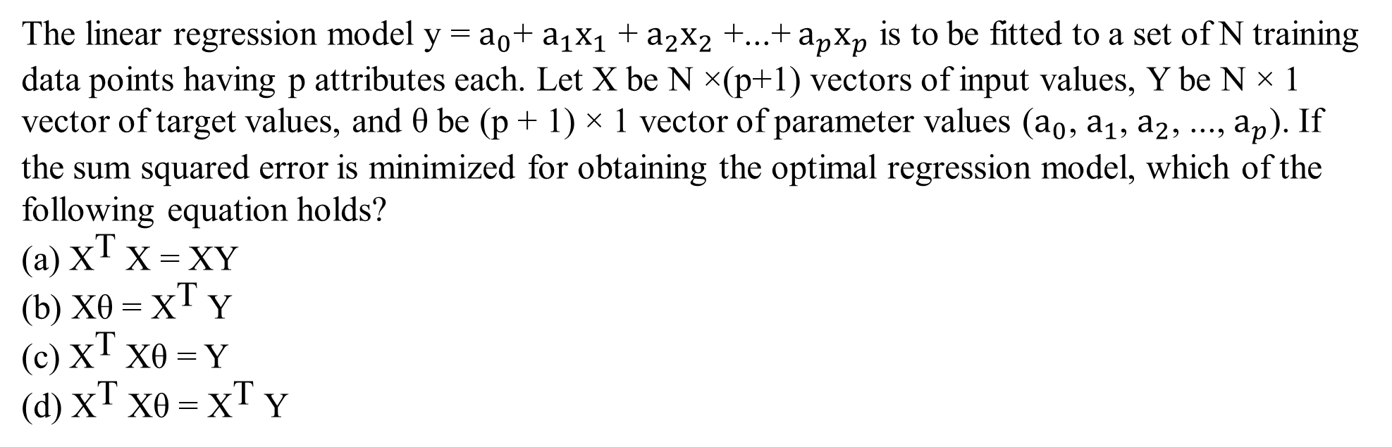
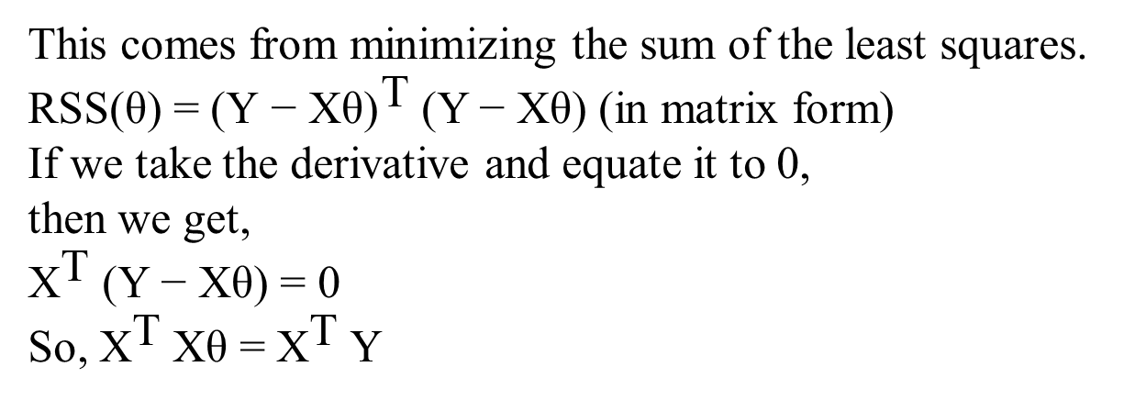
QUESTION 9
SOLUTION 9
CORRECT ANSWER 9
d)

Slide 21
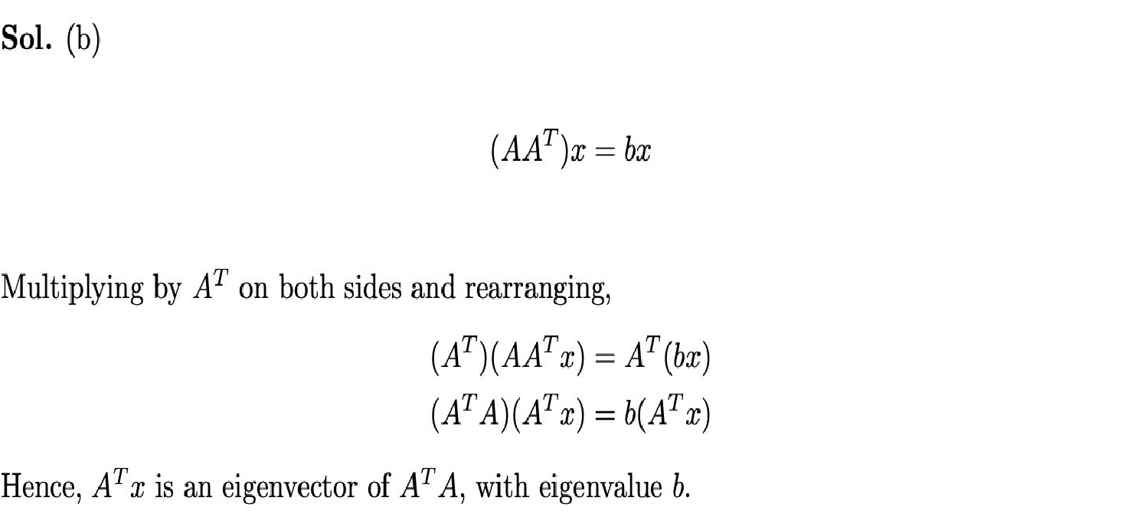
QUESTION 10
Let A^{m×n} be a matrix of real numbers. The matrix AA^{T} has an eigenvector x with eigenvalue b. Then the eigenvector y of A^{T} A which has eigenvalue b is equal to
a) x^{T} A
b) A^{T} x
c) x
d) Cannot be described in terms of x
SOLUTION 10
CORRECT ANSWER 10
b)

